Slide 1
Long Island Population Health Improvement Project (LIPHIP)
May 17, 2016
This meeting is now being recorded.

Slide 2
PHIP Grant Update
Grant Funding Period
Spending restrictions

Slide 3
Growth of LIHC Membership
Membership
NYS DOH Healthy Resources
Networking Event Blast VS. LIHC Calendar
Networking Event Blast: To promote member fundraising or networking events
LIHC Calendar: Those events focused on learning about health resources or participating in healthy activities

Slide 4
LIHC Website, Portal and Social Media
Social Media Engagement Report
Toolkit for Promotion of Website
Outreach Assessment Activity

Slide 5
April Social Efforts
With the launch of the Long Island Health Collaborative website in mid-April, the social media efforts of the LIPHIP on behalf of the Long Island Health Collaborative began to take on a new structure
This structure included concentrated promotion of both the new site and of its thoughtfully developed content, alongside the previous efforts of highlighting Collaborative and member events and successes via individual posts.
With our social efforts now able to link back to a website, and our first boosted Facebook post, our engagement numbers shot up near the end of April, with steady increases on the horizon.

Slide 6
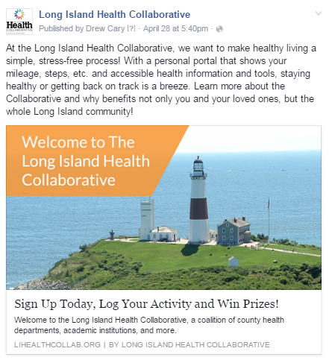
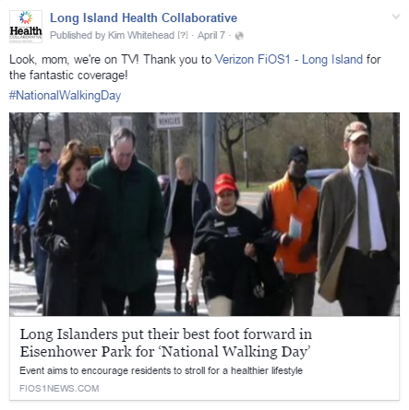
Facebook
Total likes: 152
Net likes: 42
Organic: 41
Boosted likes: 3
Total Reach: 15,216
Total Engagement: 541
Total Posts: 18

Slide 7
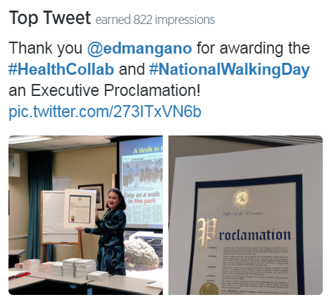
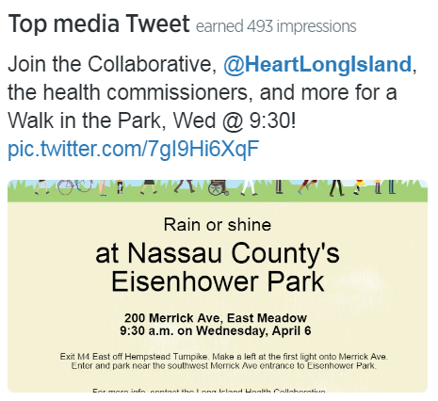
Twitter
Total followers: 151
Net followers: 17
Impressions: 3,567
Profile visits: 389
Mentions by others: 26
Total Tweets: 18

Slide 8
Definitions
Net Likes/Followers – Net likes are the number of new likes minus the number of unlikes, giving us our total outcome.
Organic vs Boosted likes – Boosted likes are categorized as likes that occur within 1 day of viewing an advertisement, or 1 month (28 days) after clicking an advertisement. All other likes are considered organic.
Facebook Reach – Total reach is defined as the number of people who were served any activity from our Facebook Page including posts, posts to our Page by other people, Page like ads, and mentions.
Engagement – When a person interacts with a social post, by liking it, clicking on a link, expanding the text, clicking through the profile page, etc., these are considered engagements.
Twitter Impressions – An impression happens each time a users see our tweet in their Twitter feed.

Slide 9
Public Education Outreach & Community Engagement
Next workgroup meeting: Friday May 20 at 1:00pm
Promotion and Trademark of Are You Ready, Feet? ™
Sunset Stroll at Jones Beach, July 21, 2016

Slide 10
Academic Partners Survey
Status of Academic Partners Survey
LIHC Activation Engagement Partnership (LEAP)

Slide 11
LIHC Activation Engagement Partnership
Committee Description: This committee is comprised of students and community advocates who hold a vested interest in improving access, health equity and social determinants of health care within communities on Long Island. The purpose of this committee is to light a spark in community members around population health and healthy living. Volunteers must be 18 years of age or older.
Target Audience: Cross-representation from academic institutions and multi-disciplinary fields of expertise on Long Island.
Audience may include, but not limited to, those with an expertise or interest in: nutrition, health communication, public health, nursing, medicine, social engagement, peer education, general communications or public relations.
Member Expectations: Attendance at evening monthly meetings; regular review of participation in activities

Slide 12
LIHC Activation Engagement Partnership
Goals/Objectives:
Sharing of information through engagement of accessible networks (may include: academic peers, work colleagues, family, friends) and promotion of Long Island Health Collaborative Initiatives and Events
Social Media
Health Fairs
Community Events
Development of new innovative initiatives and projects as applicable
To apply: Send current resume and 250-500 word paragraph response to question below to LIHC@nshc.org “Beyond what’s on your resume, what makes you want to be involved in the mission and goals of the LIHC” Applications will be accepted on a rolling basis. Long Island Health Collaborative: For more information visit: www.lihealthcollab.org Or email LIHC@nshc.org

Slide 13
Complete Streets/Nutrition and Wellness
Creating Healthy Schools and Communities Grant NYS DOH
Eat Smart, New York (ESNY), USDA
PHIP Leveraging Existing Partnerships

Slide 14
Grant | Creating Healthy Schools and Communities NYS DOH | SNAP-Ed Eat Smart New York (ESNY) USDA
Overview | Grant Partners: Western Suffolk BOCES, Sustainable Long Island, Stony Brook University Five-year (2015-2020) public health initiative to reduce major risk factors of obesity, diabetes, and other chronic diseases in high-need school districts and associated communities statewide. Goal: to implement mutli-component evidence-based policies, place-based strategies, and promising practices to increase demand for and access to healthy, affordable foods and opportunities for daily physical activity. | Grant Partners: Cornell Cooperative Extension (Nassau and Suffolk), Family Residences and Essential Enterprises (FREE) Five-year (2014-2019)community-based nutrition education and obesity prevention program to reduce major risk factors of obesity, diabetes, and other chronic diseases in high-need school districts and associated communities statewide. SNAP-Ed ESNY utilizes a variety of hands-on education strategies in the community and partnering agencies. Goal; to implement comprehensive multi layered evidence based strategies : improve the likelihood that persons eligible for SNAP will make healthy food choices within a limited budget and choose physically active lifestyles consistent with the current Dietary Guidelines for Americans and the associated USDA Food Guidance System, MyPlate.
Target | Targeted communities: Brentwood, Central Islip, Southampton/Shinnecock Indian Nation, Wyandanch and Roosevelt | Suffolk and Targeted communities: in Nassau Roosevelt Uniondale, Glen Cove, Hempstead, Freeport,

Slide 15
10 Minute Stretch Break & Sign up for Workgroup Participation

Slide 16
Cultural Competency/Health Literacy Workgroup
Workgroup Function
Results of CBO Survey
RFP for Vendors-In development

Slide 17
CBO Survey Results
Total Survey Responses=23
Do employees of your organization regularly participate in Cultural Competency/Health Literacy training programs?
13-no (56.5%); 10-yes (43.4%)
Is this training provided by an external vendor or internally within your organization? (N=10 Yes)
7-internally provided; 1 Externally (1199 SEIU); 1 Right at Home University (online program); 1 No response
Defining and Identifying health disparities | Defining social determinants of health | Defining and identifying cultural barriers to health | Methods to gain better insight into patient/client culture and understanding cultural perspectives | Understanding personal bias and preventing it from affecting patient/client care/Unconscious Bias | Cultural perspectives on health and medicine among community members and implications for community based organizations | General understanding of health literacy and factors influencing health literacy including tools that can be used to promote and assess health literacy | All of the above
2/10 | 3/10 | 5/10 | 3/10 | 4/10 | 3/10 | 4/10 | 3/10

Slide 18
CBO Survey Results
Are you interested in providing a tailored Cultural Competency/Health Literacy Training program for staff members within your organization?
12-yes (52.1%); 5-no; 6-maybe (26%)
If your staff were to attend a training session, what is the maximum amount of time they would have allotted to participate?
Flexibility depending on program type-1 respondent
Greater than 3 hours-1 respondent
3 hours- 6 respondents
2 hours-4 respondents
1.5 hours- 3 respondents
Which method of program delivery is most desirable to your organization? Please rank the following in order of importance, where 1 is most important and 3 is least important;
#1-Face to Face (24 points)
#2-Facilitated Live (32 points)
#3-Recorded Webinar (46 points)

Slide 19
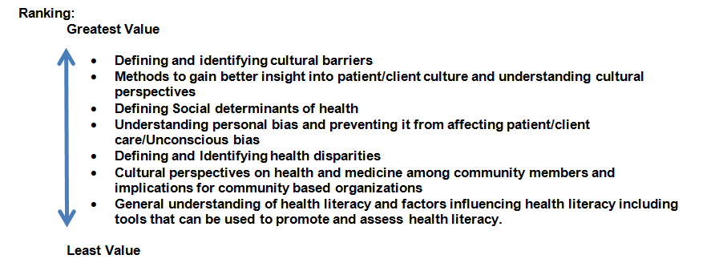
CBO Survey Results
Which Cultural Competency/Health Literacy curriculum topics have greatest value to your organization?

Slide 20
Data Workgroup
Review of Prevention Agenda Priorities Selected
Community Member Survey
Nassau and Suffolk Qualitative Data Reports: CBO Summit Events
PHIP-Specific Community Health Assessment Template-June 10, 2016
Data available via LIHC website

Slide 21
Data Workgroup Continued..
Status of County Reports: Vital Statistics
Wellness Portal and Complementary Training Session for Wellness Survey Use
Suffolk Care Collaborative Partnership

Slide 22
DSRIP Performing Provider System Partnerships
Long Island Health Networking Expo as a follow up to CBO Summit Events

Slide 23
Grant Opportunity
Healthiest Cities and Counties Challenge-Grant Opportunity

Slide 24
Healthiest Cities and Counties
Aetna, APHA, NACo
Vision:
Support communities in their collaborative efforts to become healthier places to live, work, learn, play and pray
Recognize excellence in achieving a measurable impact as a result of these efforts
Identify models of effective collaboration that can be sustained and replicated throughout the US

Slide 25
Healthiest Cities and Counties
Must pick at least one domain from Table 1
From selected domain the program must address at least one metric.

Slide 26
Healthiest Cities and Counties
How does the project address population health and health equity in target communities?
What cross-sector collaborations will be used to establish or build upon between health and other sectors?
What measures will the cross-sector team use to evaluate the changes?
Is the project replicable and sustainable?
What evidence based practices are part of the project, program or policy being proposed which will lead to positive changes in health and health equity in the community by the end the challenge?
How will information be shared about the project, program or policy to the community and beyond?

Slide 27
Questions/Feedback?

Slide 28
Upcoming Meetings
June 16, 2016 9:30-11:30am
August 11, 2016: 9:30-11:30am

